Slide 1
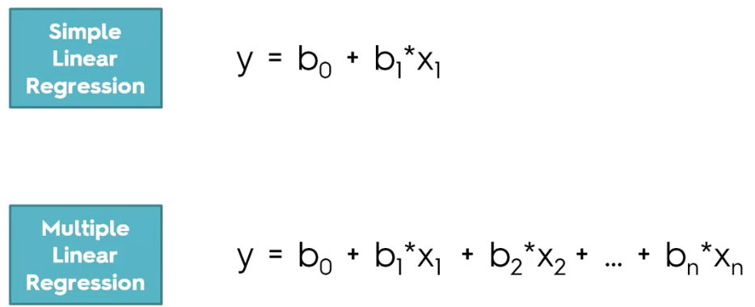
Regressions:

Slide 2
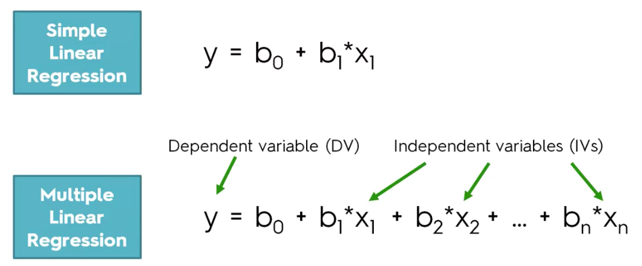
Regressions:

Slide 3
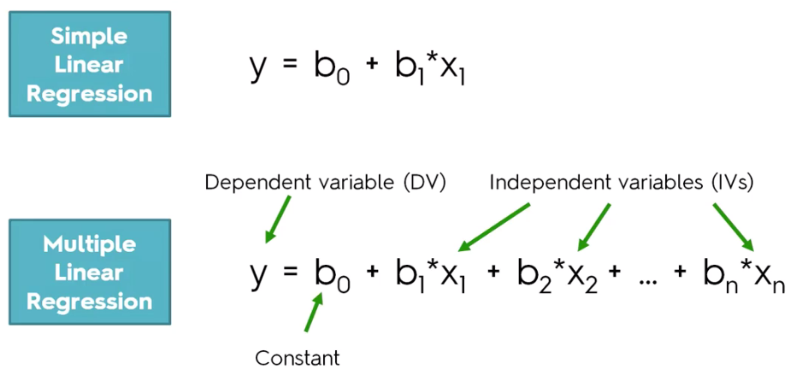
Regressions:

Slide 4
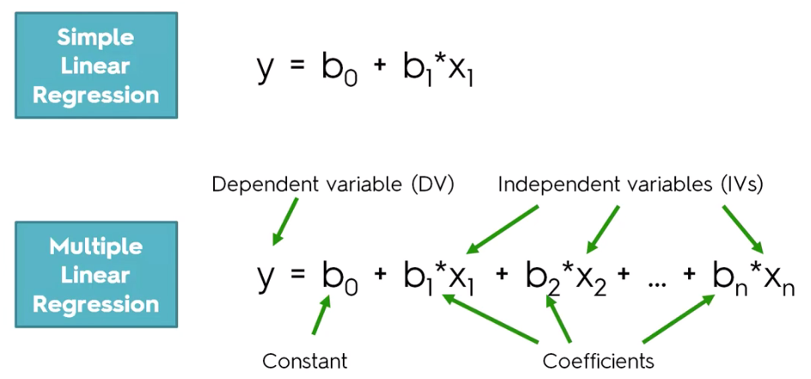
Regressions:

Slide 5

Building a Model:

Slide 6
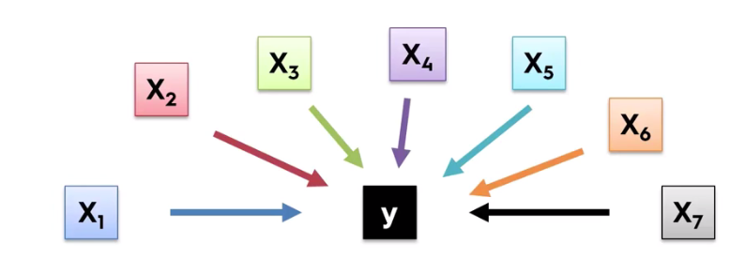
Building a Model:

Slide 7
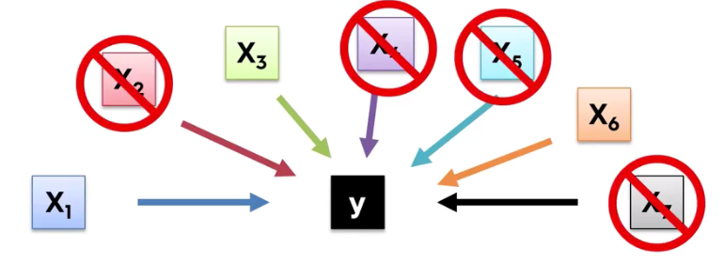
Building a Model:

Slide 8
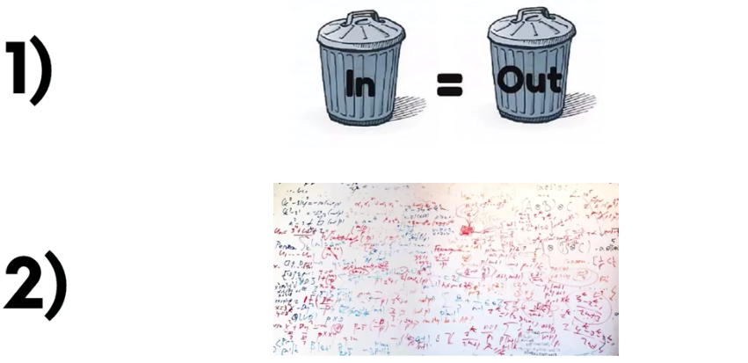
Why you get rid of Columns:
Not be able to explain the thousands of variable to the management.

Slide 9
Methods of Building the Model:
The process of constructing the model by selecting the right variables.

Slide 10
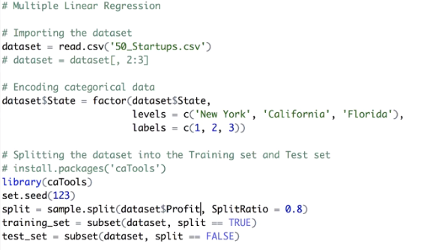

Slide 12

Dot use for all independent variables
summary(regressor)

Slide 13


Slide 14

Backward Elimination

